Slide 1


FYP-2
CryptoCamGuard-Elevating Image Security App
Submitted By:
Sardar Nazeer 2630-2021
Ali Sher Sial 2201-2021
Supervisor Sir Saifullah Adnan
Department of Computing, FEST
Hamdard University

Slide 2
Summary
Problem Statement
Objective
FYP Scope
Our methodology
Our Project Plan (Time lines)
Budget / Costing (if any)
FYP Deliverables
Literature Review
Demo of 100% of Work
Experimental Evaluations & Results
Test Plan & Test Cases
References

Slide 3
Problem Statement
Today, people store personal and sensitive images like family photos or documents on their mobile phones.
However, these images are not well protected. If the device is lost or hacked, anyone can access them easily.
Key Issues:
Manual Handling: Users must manage image security manually, which is time-consuming and unreliable.
Lack of Transparency: Users don’t know who can access their images or how securely they are stored.
Inefficiency: Built-in gallery apps are not designed for privacy or secure organization.

Slide 4
Objective
CryptoCamGuard aims to give users a safe and secure way to take, encrypt, and store personal photos. It protects images from unauthorized access and helps users keep full control of their private memories.
Key Features
Auto Encryption – Photos are encrypted as soon as they are captured.
Easy to Use – Simple and clean interface for all types of users.
Secure Storage – Images are saved inside the app, not in the gallery.
Login Protection – Only authorized users can access the app.
Fast Performance – Smooth photo handling without delays

Slide 5
FYP Scope
Develop a mobile app that securely captures and stores personal images.
Implement advanced encryption (e.g., AES) to protect images from unauthorized access.
Create an easy-to-use interface so users can navigate the app without technical knowledge.
Ensure performance optimization so the app works quickly and smoothly.
Allow access to encrypted images only through the app using proper authentication.
Not in scope:
Encryption of non-image files.
No image sharing or file transfer features

Slide 6
Our Methodology
Design Methodology
Human-Centered Design (HCD): Focus on real user needs to make the app intuitive and easy to use.
User Experience (UX) Design: Ensure a smooth, secure experience while encrypting and accessing images
Agile Design: Use an iterative design process improve design step-by-step based on feedback.
Development Methodology
Agile Development: Break the work into small, manageable tasks using sprints and feedback loops.
Scrum Framework: Daily stand-ups, sprint planning, and continuous delivery for better team collaboration.
Secure Development Life Cycle (SDLC): Security is integrated into every stage of development from planning to deployment.

Slide 7
Our Project Plan
Project planning:
July-Aug: Research & Planning
Sep-Oct: UI/UX Design
Oct-Jan: Frontend Development
Jan-Mar: Backend Development
Apr: Testing & Bug Fixing
May-June: Final Report, Demo & Submission

Slide 8

Giant Chart

Slide 9
Budget / Costing
Component | Details | Estimated Cost (PKR)
Development Tools | Android Studio, SDKs, PostgreSQL | 0
Design Tools | Figma (Free plans used) | 0
Testing Devices | Personal Systems | 0
Internet & Utilities | Used for development, testing, and documentation | 1,000
Poster Printing | For final year project display | 800
Report Printing & Binding | Final report, documentation hardcopy | 1,500
Contingency / Miscellaneous | Transport, backup USB, stationery, etc. | 1,000

Slide 10
FYP Deliverables
Mobile application: CryptoCamGuard for secure image capture, encryption, storage, and access.
Source code repository with clear documentation and version control (via GitHub).
Final FYP report (Red Book) with detailed design, methodology, testing, and evaluation.
User manual and usage guide.
Presentation and poster for final year display.
Test plan with test cases and execution results.

Slide 11
Literature Review
CryptoCamGuard is built on the foundation of advanced image encryption and privacy preservation. Studies reviewed include:
"Image Encryption Techniques: A Review" (2020) — Discusses chaotic and DNA-based encryption methods.
"Encryption for Image and Video Data: A Review" (2018) — Focuses on secure multimedia data encryption techniques.
Existing apps like Signal, Tresorit, and PixelKnot were analyzed for strengths and limitations.
What Sets CryptoCamGuard Apart
Dedicated focus on image security (unlike general file-sharing or messaging apps).
On-device AES-256 encryption applied at the moment of capture.
Seamless user experience without exposing files to unencrypted storage.

Slide 12
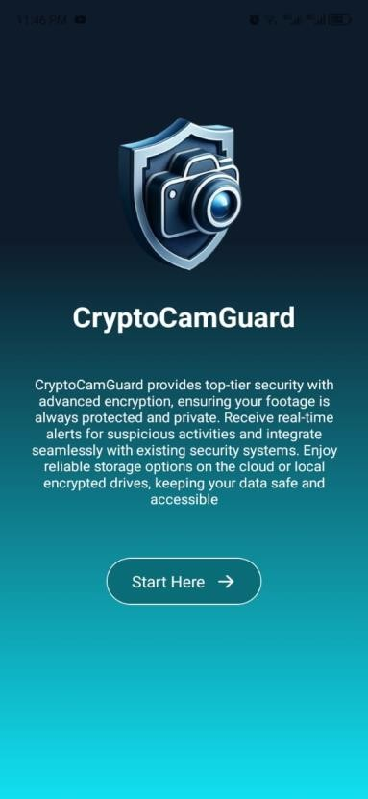
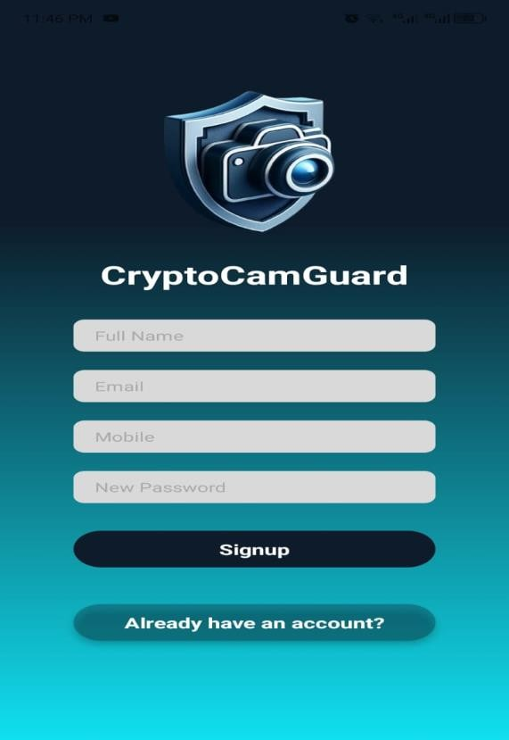
Demo of 100% of Work
To navigate the signup page

Slide 13
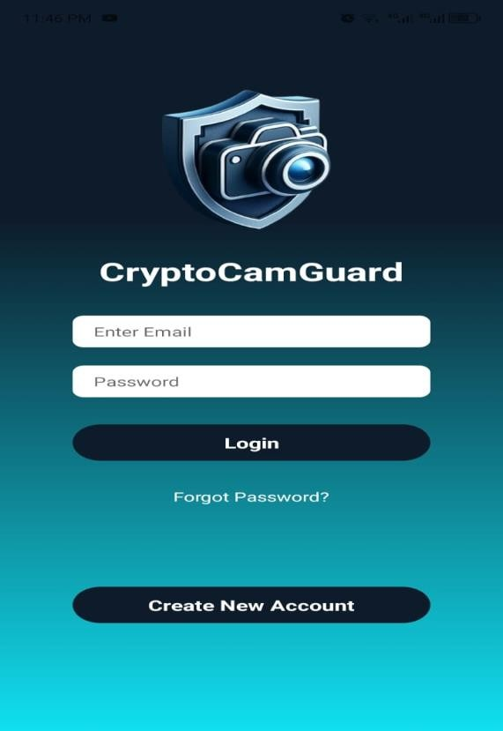
Demo of 100% of Work
After the user's account is created and they log in from here, they will be directly navigated to the home page that I showed you above.

Slide 14
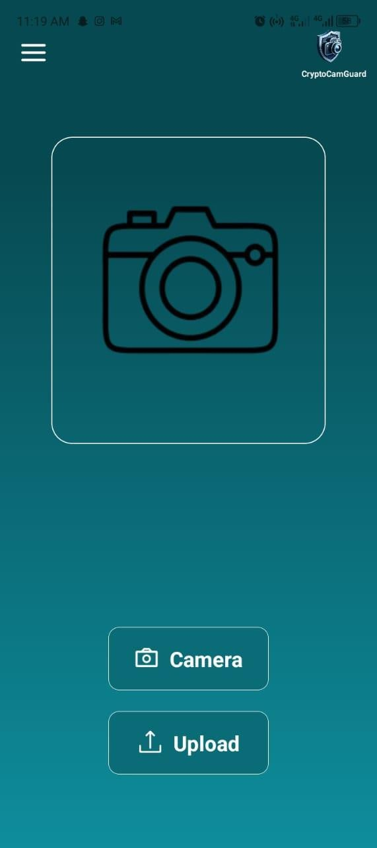
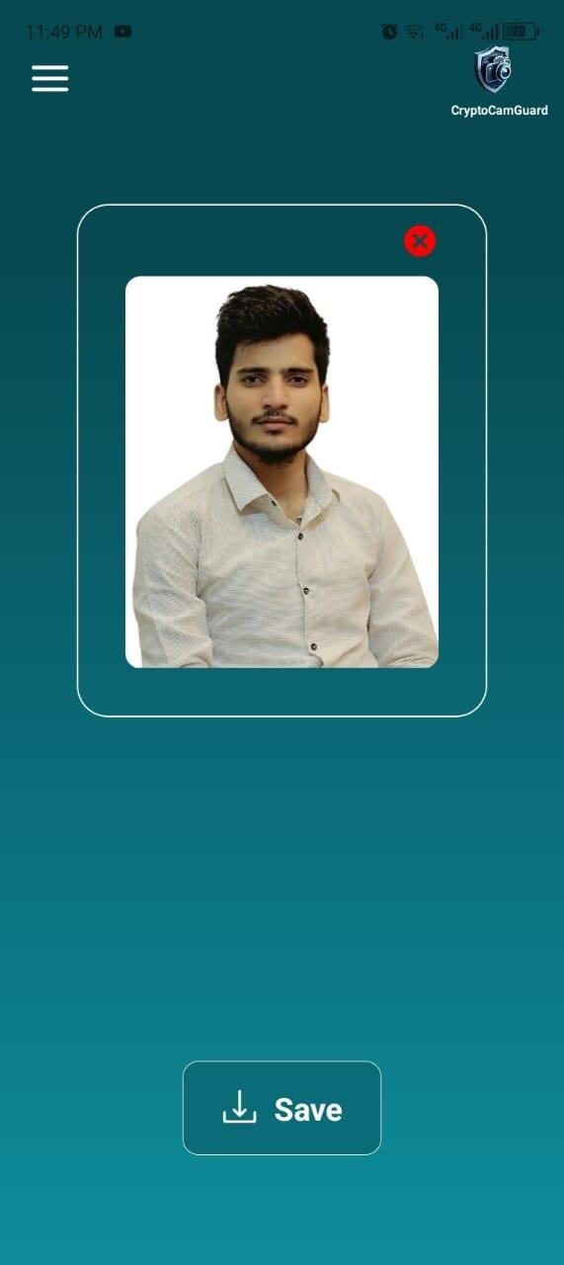
Demo of 100% of Work
You need to select the camera from here to capture the image
By saving here, the image will be moved to the application's gallery.
Otherwise, you can also directly select an image from your gallery here

Slide 15
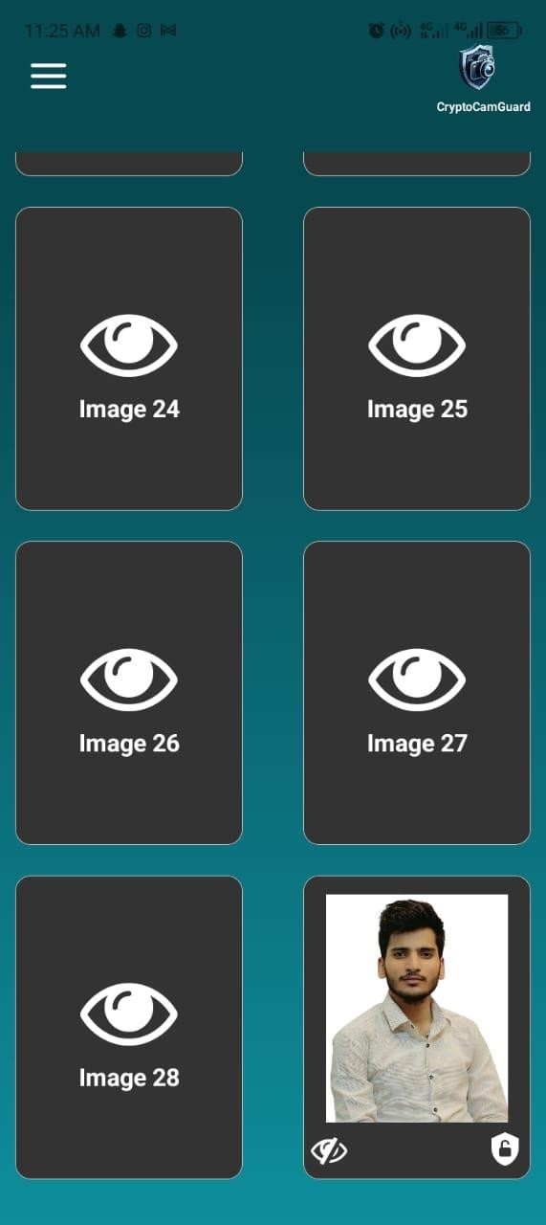
Demo of 100% of Work
h
resulting in a fully encrypted image file.
All these are encrypted images that the user cannot view until they decrypt them themselves

Slide 16
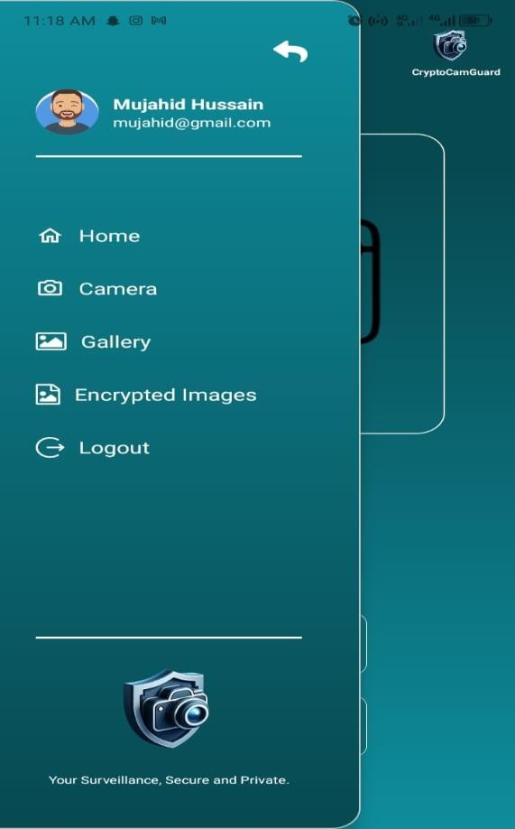
Demo of 100% of Work
With the help of this sidebar, the user can navigate to the home page. If they want, they can also open the camera from here. Additionally, if the user wants to sign out, they can go to the sidebar and click the sign-out button.

Slide 17
Experimental Evaluations & Results
Encryption Efficiency: AES-256 implementation ensured images were encrypted instantly after capture.
Security Validation: Encrypted files were resistant to access even after device extraction.
User Testing: Demonstrated intuitive UI and successful completion of all core tasks (image capture, encryption, viewing).
Scalability Testing: The app performed well under concurrent image loads and access operations.
Proof of Concept: End-to-end functioning app proving the technical feasibility of secure image management.

Slide 18
Test Plan & Test Cases
Front-End Testing:
Unit tests using Jest and React Native Testing Library.
Manual UI/UX testing on different screen sizes.
Back-End Testing:
Unit and integration tests with Mocha and Postman.
API endpoint testing for authentication, image handling.
Security testing for unauthorized access attempts.
Sample Test Cases:
Test Case 1: Image is captured and encrypted without error.
Test Case 2: Encrypted image cannot be opened in external gallery.
Test Case 3: Only logged-in user can view/decrypt stored images

Slide 19
Reference
• Tresorit uses encryption technology to protect your files end-to-end, meaning no third-party or service provider can access them from upload to download.Overall, Tresorit is a safe and secure way to store and share your sensitive data. For more information, visit their website directly. https://tresorit.com/
• PixelKnot is an Android app that allows you to hide messages within images and share them securely through any messaging platform. Its main purpose is to keep your images secure and aid in sharing them confidentially. PixelKnot utilizes steganography, meaning it hides your messages within the pixels of images, making them appear normal but containing hidden information. Pixel Knot

